Slide 1
THUAS presents

Slide 2
International Marketing Week 2023

Slide 3
11-14 April 2023
( Tuesday -Friday )
250 euros
Accommodation
All Breakfasts
All Lunches
Transportation
various activities
Gala event
School facilities
Arrival on Monday 10 April
2nd & 3rd year marketing students
40 spots available
Exporting your brand abroad
You’re welcome!

Slide 4
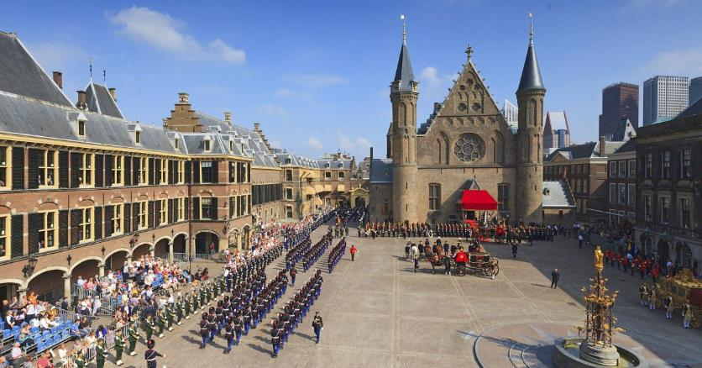
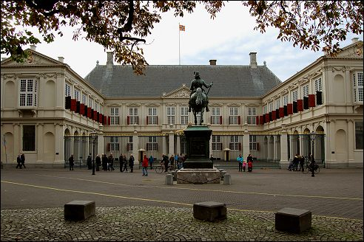
The Hague
Royal residence
Seat of Government
City of International Justice

Slide 5
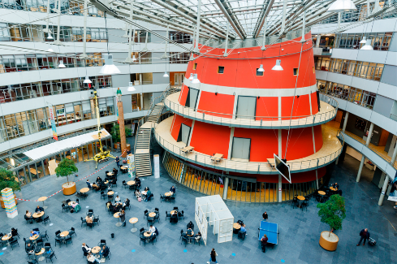
26,000 students
140+ nationalities
4 campusses
50+ bachelor programmes
9 master programmes
450+ exchange partners
30+ research groups

Slide 6
Experience marketing

Slide 7
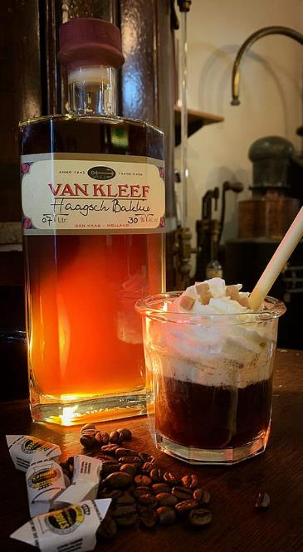
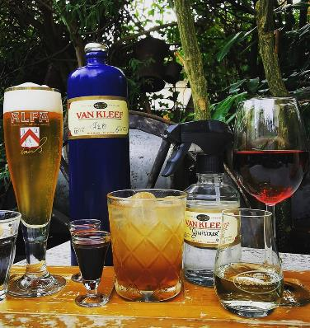
Devising an export strategy for two spirit brands

Slide 8
Task 1
Investigate the local market assigned to you and devise a marketing entry strategy

Slide 9
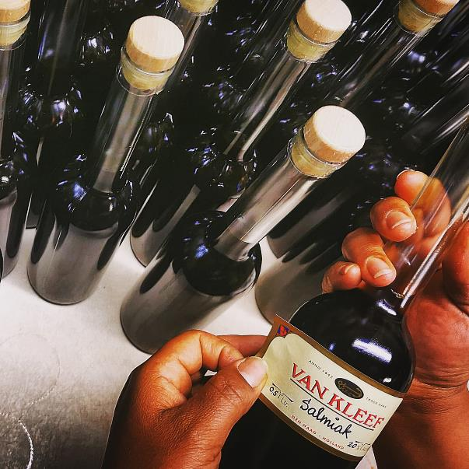
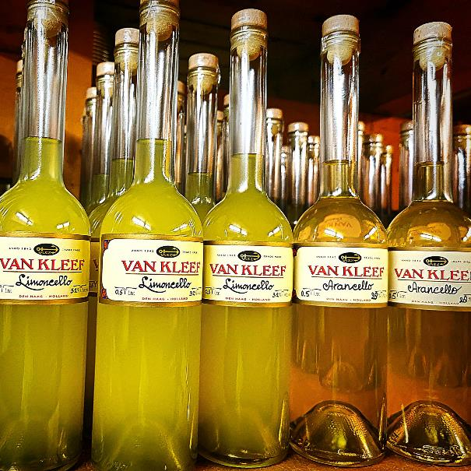
Task 2
Create an a4 colour ad for the product

Slide 10
Task 3
Come up with a brand name and catchy slogan to fit your local market!

Slide 11
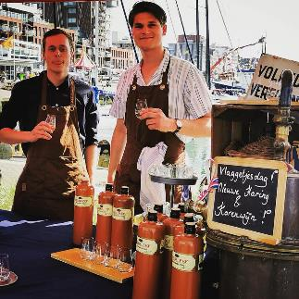
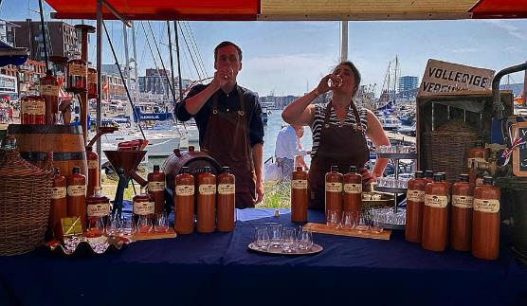
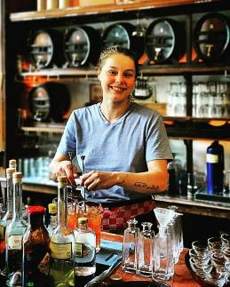
The programme includes a visit to the van kleef museum in the hague and a free spirits tasting session!

Slide 12
Schedule ( provisional )
Monday 10 April
Afternoon arrival
dinner students
dinner visiting teachers

Slide 13
Schedule ( provisional )
tuesday 11 April
Welcome & intro
Home assignment presentations
Company assignment briefing
Branding workshop

Slide 14
Schedule ( provisional )
wednesday 12 April
Work on assignment
Potluck lunch
Scavenger hunt and drinks in the hague

Slide 15
Schedule ( provisional )
thursday 13 April
Working on project
Company visit & tasting sessions
Gala dinner & dance

Slide 16
Schedule ( provisional )
friday 14 April
Working on project
Final presentations
Award ceremoney & goodbye
farewell drinks

Slide 17
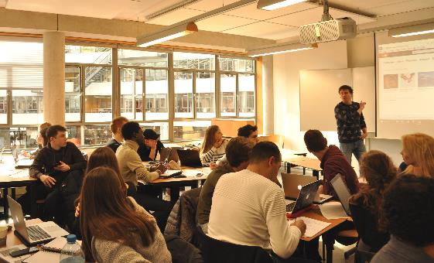
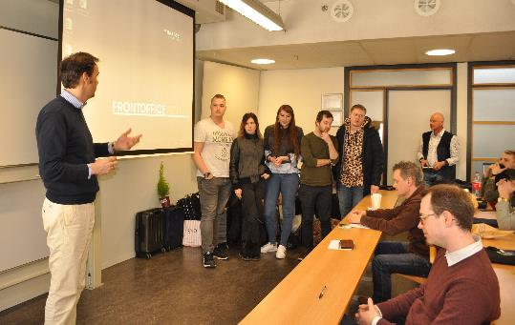
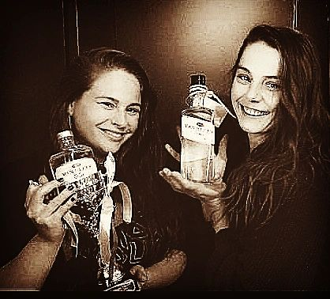
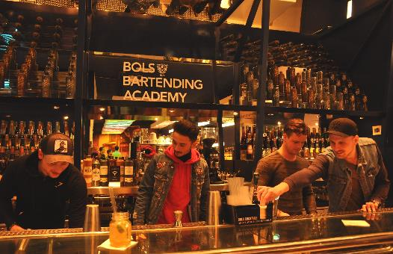
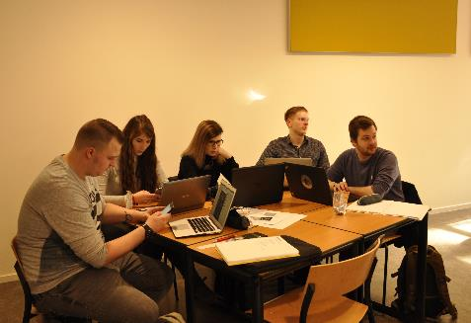
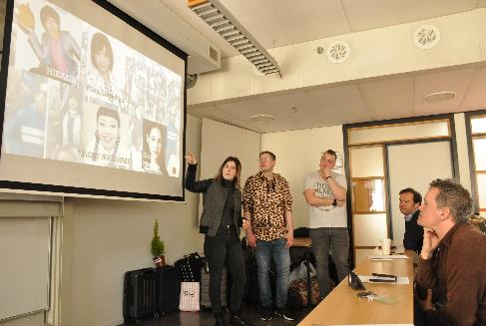
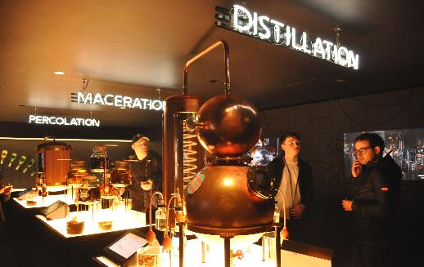
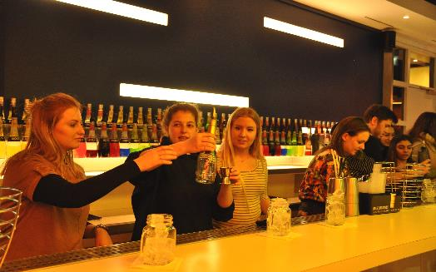

Slide 18
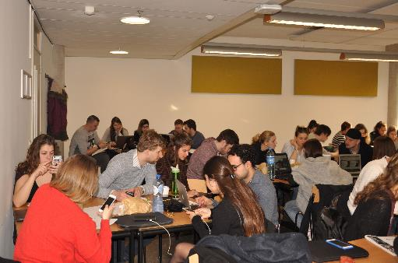
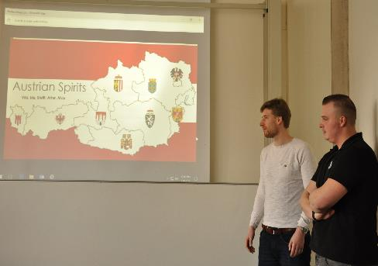
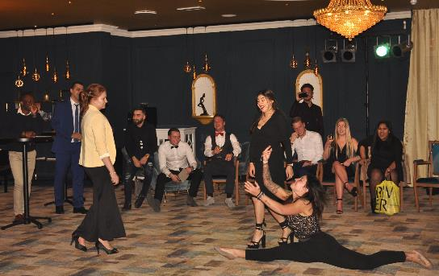
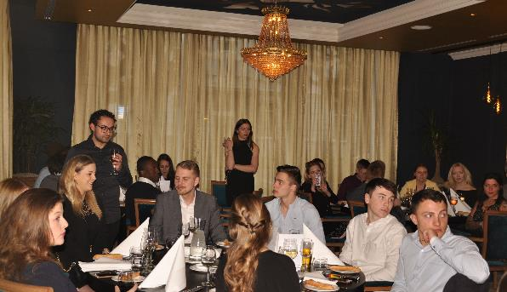
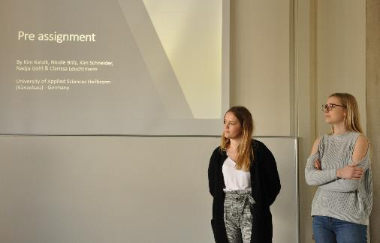
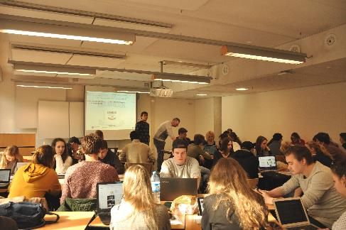
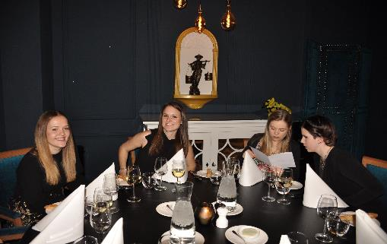

Slide 20
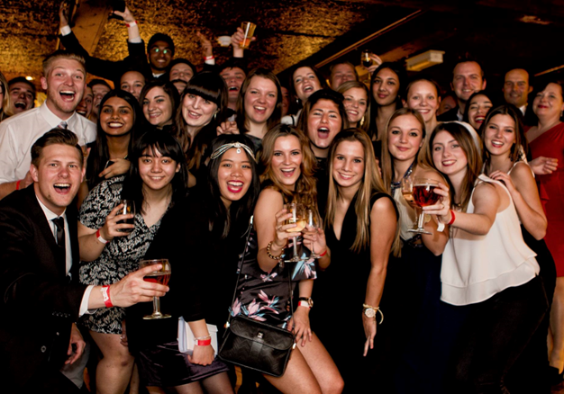

Slide 21
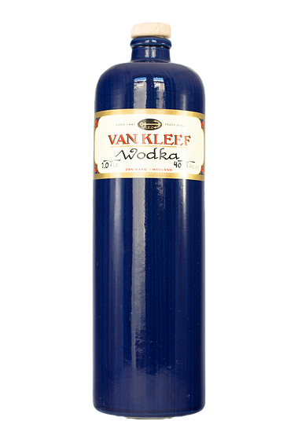
Students will work in small international groups on a marketing assignment for a specific market assigned to them
Students register via the registration form ( to be sent to you shortly )
Visiting teachers are welcome to join ( we have a separate registration form for them )
Senior students from the THUAS marketing programme will accompany them throughout the week
Application deadline: 15 January 2023
Teacher support and school facilities will be available during the project
5 spots per partner available, contact us if more needed

Slide 22
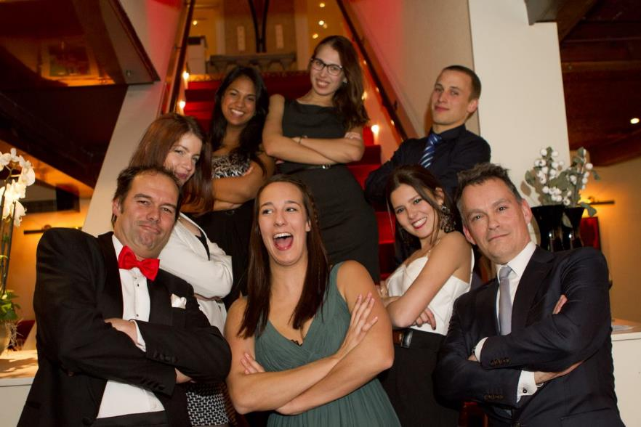
Organising committee
Pieter de Vos
p.w.devos@hhs.nl
Richard Santalla
r.m.santalla@hhs.nl

Slide 23
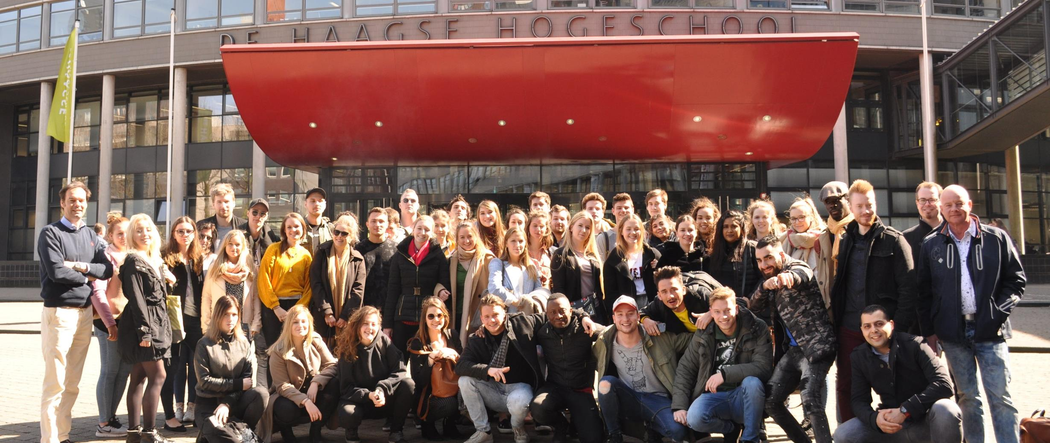
questions?

Slide 24
