Slide 1
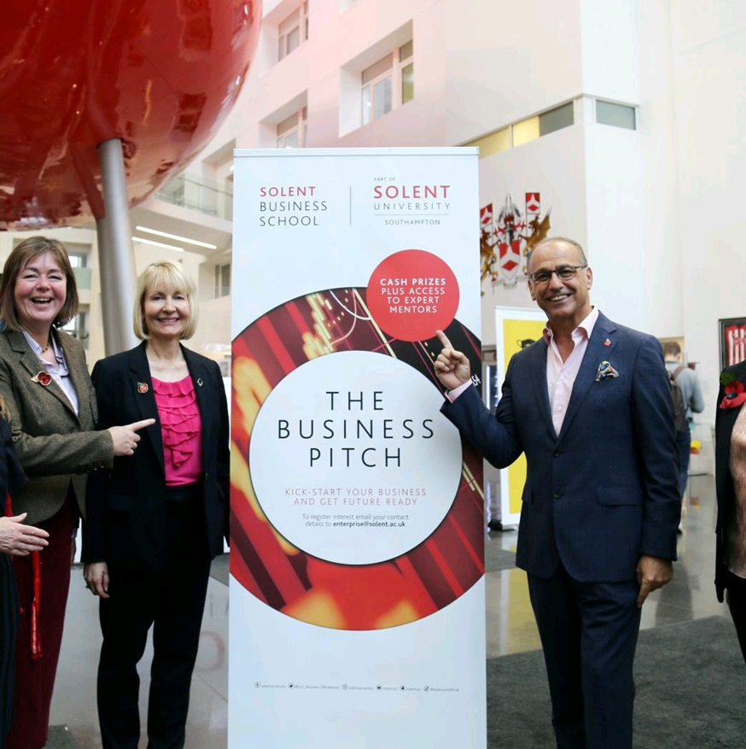
Welcome to the Solent Business School
Joanne Hooker & Pilar Garrido Sanz

Slide 2
We are an excellent Business School
We hold the Chartered Association of Business Schools, Small Business Charter. One of only 62 Business Schools to have this acknowledgement of excellence in working with SMEs
3rd in the UK for graduate business start-ups – top ten for 5 years running
(HE-BCI

Slide 3
What Southampton Offers
Ancient history
Digital Tech Hub
Short listed for City of Culture
Connected community
University friendly city
Easily connected to UK and world
Beautiful location

Slide 4
Solent IMW
Dates:
TBC
Cost:
approx. £300.00 Includes: Bed & Breakfast, some lunch and up to 2 dinners.
Accommodation:
Shared room in hotel for students 3 mins from Uni
Single staff room in separate hotel in city centre
Over 18 only

Slide 6
Schedule
Sun
Arrival
Free day
Mon
Briefing by client
Managing international teams session
Guest lecture –
International dinner
Tues
Ideation and working on creative projects session
Working in teams on the brief
Free evening to explore Southampton
Wed
Working in teams on the brief
Afternoon feedback on work so far
Online meeting with the client
Thu
Prepare final presentations
Student Celebration Party & Dinner
Fri
Feedback from client on presentations
Afternoon depart after 2pm

Slide 7
There are several potential dates 2023 we could look at :
27th March – 31st March
17th April – 21st April
And also,
24th April -28th April ( this is an assessment week so less preferable)
20th March – 24th March
slido.com with #3292715

Slide 8
Contact us
Joanne Hooker
Head of PG, Apprenticeships and Enterprise
Joanne.hooker@solent.ac.uk
Pilar Garrido Sanz
Senior Lecturer in Leisure and Marketing
Maria.garridosanz@solent.ac.uk

Slide 9
Thank you Any questions?

