Slide 1
The Creative Marketing Plan
Case: SKÆRSØGAARD
- The first licensed and most highly awarded estate winery in Denmark

Slide 2
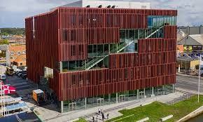
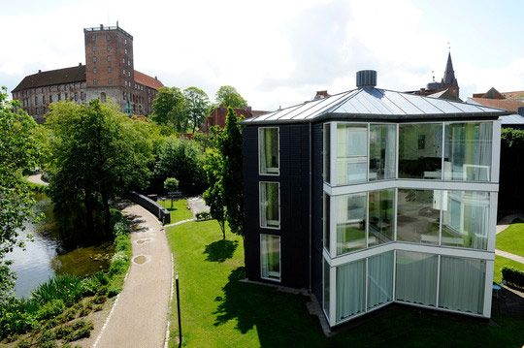
Join International Marketing Week in 2023 Kolding, Denmark
Date | March, Monday 27 to Firday 31, 2023 (avirral Sunday March 26)
Place | International Business Academy in Kolding, Denmark (near Billund Airport)
Accommodation | Kolding Hotel Apartments, 5-6 students per apartment, 3 bedrooms per apartment and one bathroom
Price | 290 Euro. Includes accommodation (Sunday to Friday), Social activities, breakfast and lunch every day + Two dinners.
New campus (2019).
Situated 5 minutes from city centre
Kolding Hotel Apartments
Situated 10 minutes from IBA in beautiful location by the lake

Slide 3
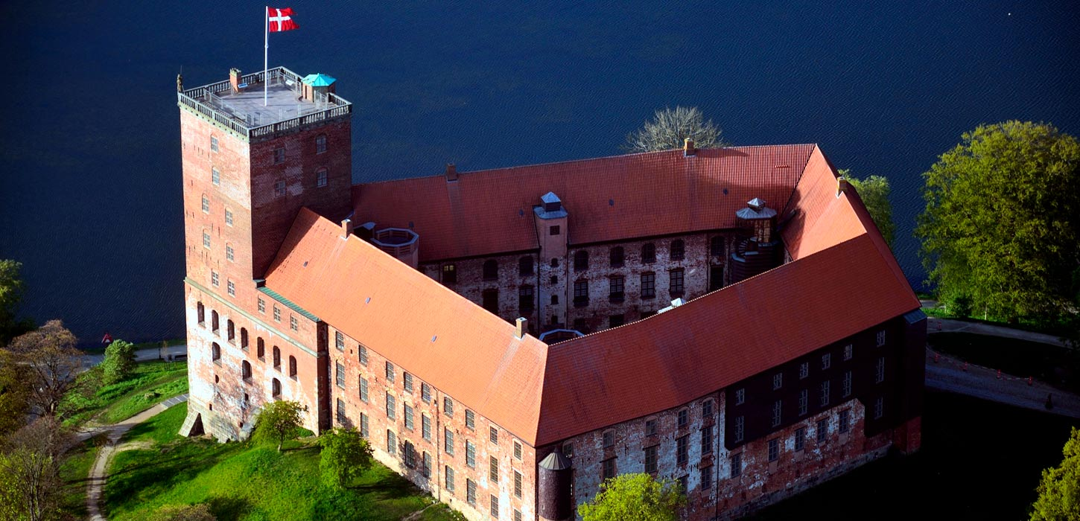
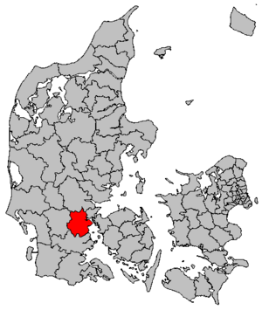
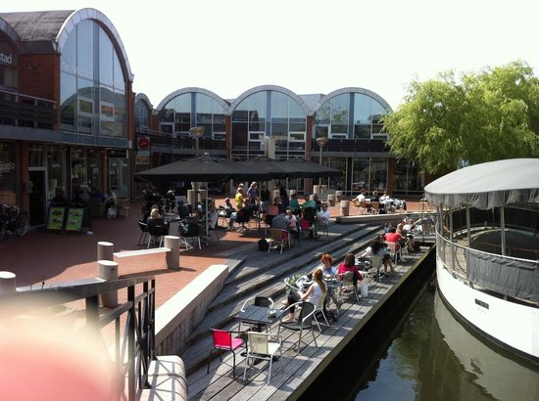
Have you ever been in Denmark? Well, here is your chance!
Denmark
More than 5 million inhabitants
Capital City – Copenhagen
Form of state – monarchy (the oldest uninterrupted European monarchy)
Kolding
7th largest city of Denmark (population 58,000)
Regional center of creativity, innovation and design
Student and tourist hub
Only 45 kilometres from the airport in Billund.
Koldinghus castle
Kolding city centre

Slide 4
What to expect
Work on a business case together with the involved company.
Work in international teams with students from different countries
Participate in various social and cultural arrangements during the week

Slide 5
Introducing the business case
In 2018, the European Union granted Denmark its very first wine region.
The wine region DONS is Denmark’s first and the EU’s northernmost appellation, on equal terms as the perhaps more famous regions of Bordeaux, Champagne, La Rioja, and Piedmont
The wine region DONS consists of 500 hectares of the glacial valley in the innermost part of Kolding Fjord, near the hamlet of Dons. The estate winery of Skærsøgaard is centrally located in the wine region and produces acclaimed sparkling quality wines.
The designation DONS (PDO) ensures a certified standard of quality.
Source: Skærsøgaard vin - Første autoriserede og mest præmierede vingård i DK (dansk-vin.dk)

Slide 6
Creating the creative markeitng plan
Champagne is a well-known brand. The wine region of Dons and the winery Skærsøgaard, however…. well, not so much!
Your task as brilliant marketeers is to change that.
With marketing tools and skills such as research, segmentation, customer journeys and knowledge about communication and platforms, your task is to create a creative, feasible and awesome marketing plan including creative content for Skærsøgaard winery.

Slide 7
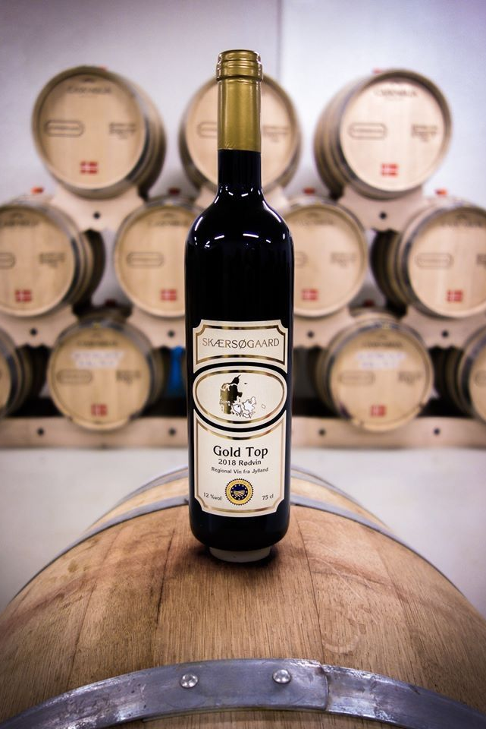
Inspiational field research
We will visit Skærsøgaard winery to learn much more about the brand and how to produce wine in Denmark. Perhaps they will even let us taste the goods.
Furthermore we will visit the Viking Museum in Jelling. Jelling was the capital in Demnark when the Vikings ruled. We will visit the Viking Monument build by the first Viking King, Harald Bluetooth. The monument he build for his parents was the biggest of its time, and also contains the baptism of Denmark. The Knowledge gained here, could inspire you in your work.

Slide 8
A few details
Up to 5 students from each university
Registration online (by your local coordinator)
Every student receives a certificate for participating in the project and a mark is given
Deadline for enrollment; January 16th 2023
After enrollment, we will invite you to join a Micosoft Team forum. Here we provide you with more project information and we will introduce a pre-assignment we want you to solve before meeting in Kolding.
See you in Denmark!

